Slide 1
MM442/642
Seat Lightweighting Project
(15 marks)

Slide 2
Objective of the project
As a part of Six-Sigma quality project, the automotive manufacturer wants to reduce the weight of the car seat.
Car seat forms a significant amount of the total weight of the car. Any reduction
in its weight can have a significant impact in terms of benefits of lightweighting.

Slide 3
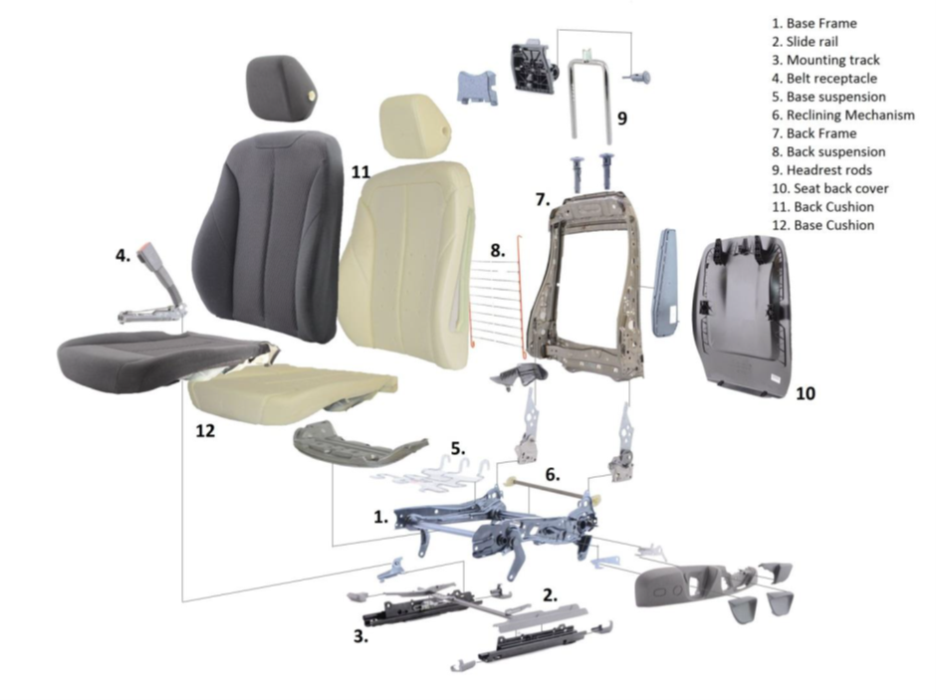
Exploded view of car seat design

Slide 4
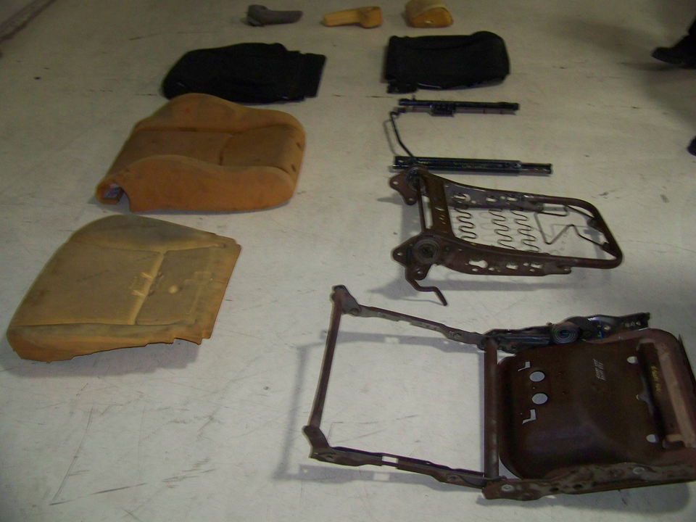
Seat Teardown Assembly

Slide 5
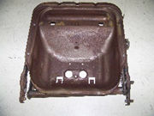
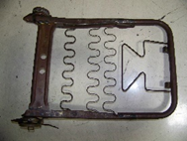
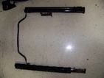
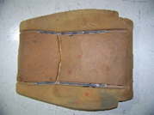
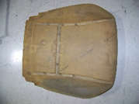
Bill of Materials
Sr.No | Part | Image | Material | Weight
1 | Base Frame Assy |  | Mild steel | 5.782
2 | Back Frame Assy |  | Mild steel | 4.236
3 | Slider Assy |  | Mild steel | 3.75
4 | Backrest Foam |  | PU foam | 1.35
5 | Seatbase Foam |  | PU foam | 1.36

Slide 6


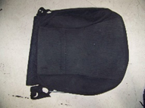
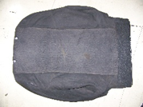
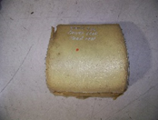
Bill of Materials
Sr.No | Part | Image | Material | Weight
6 | Handrest Foam |  | PU foam | 0.526
7 | Handrest cover |  | polyester | 0.044
8 | Seatbase cover |  | polyester | 0.28
9 | Backrest cover |  | polyester | 0.458
10 | Headrest Foam |  | PU foam | 0.212

Slide 7
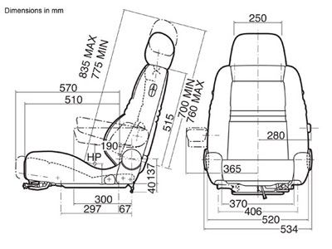
Typical seat dimensions

Slide 8
Procedure
1. Note the material and function of each part. Prepare the bill of materials in the following form
Part | Role | Material | Weight
2. Make suggestions for lightweighting at least 2 parts using alternative materials. The lightweighting suggestions can be based on materials substitution, re-designing of the assembly itself or a combination of the two.

Slide 9
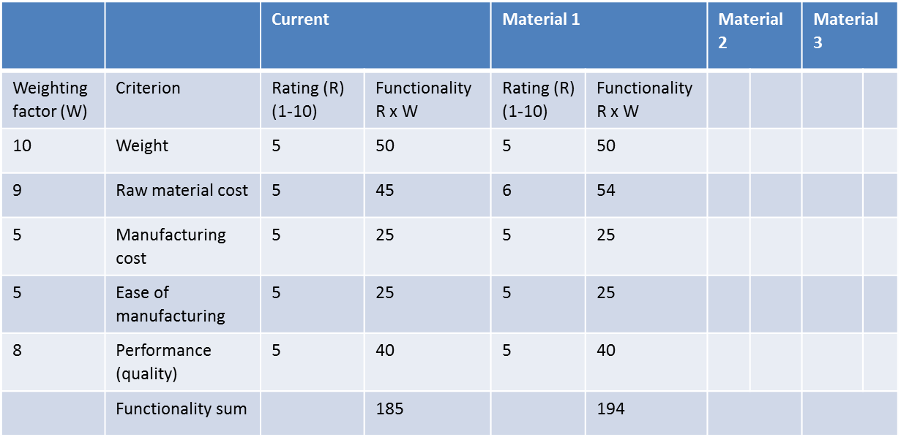
3. Use Pugh analysis as below to compare the lightweighting material options. The selected parts could be assembly or collection of smaller parts. The material giving best results in Pugh analysis would be selected as alternative.

Slide 10
4. Justify the ratings given to different alternatives.
5. Presentation on the exercise in the middle of the semester
- Include the relevant information on seat design, lightweighting, material alternatives, justification
of ratings etc
- Everyone in the group has to contribute in presentation
- Marks (10 marks) are given for the quality of the activity, content of presentation, and presentation
skills
6. Write down the solution of this exercise as a report (5 marks) – submit soft copy by email.

Slide 11
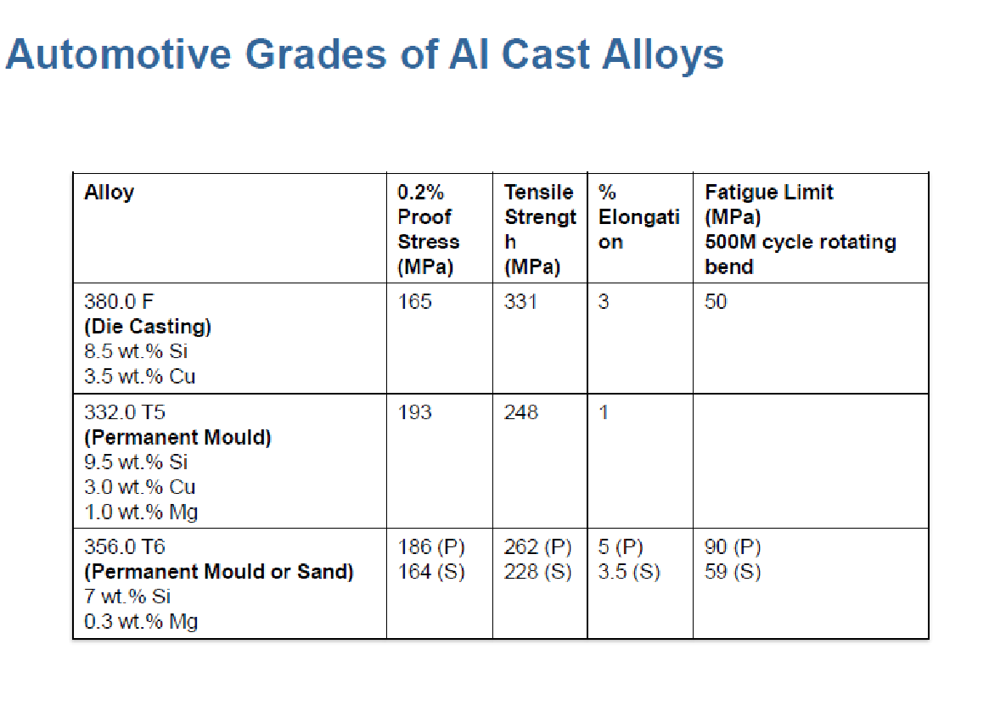
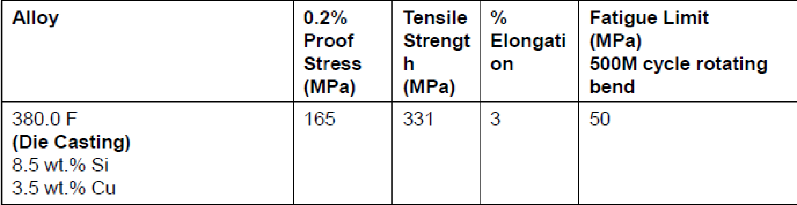

Slide 12
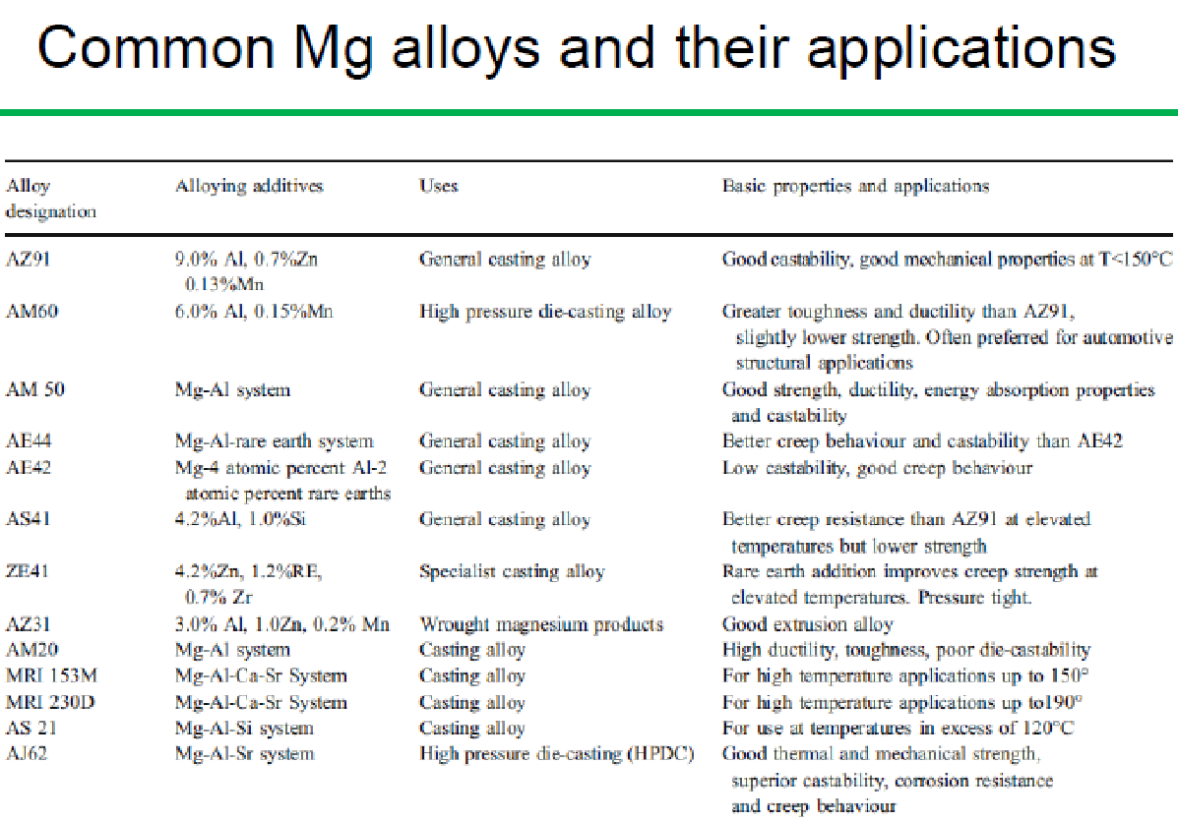

Slide 13
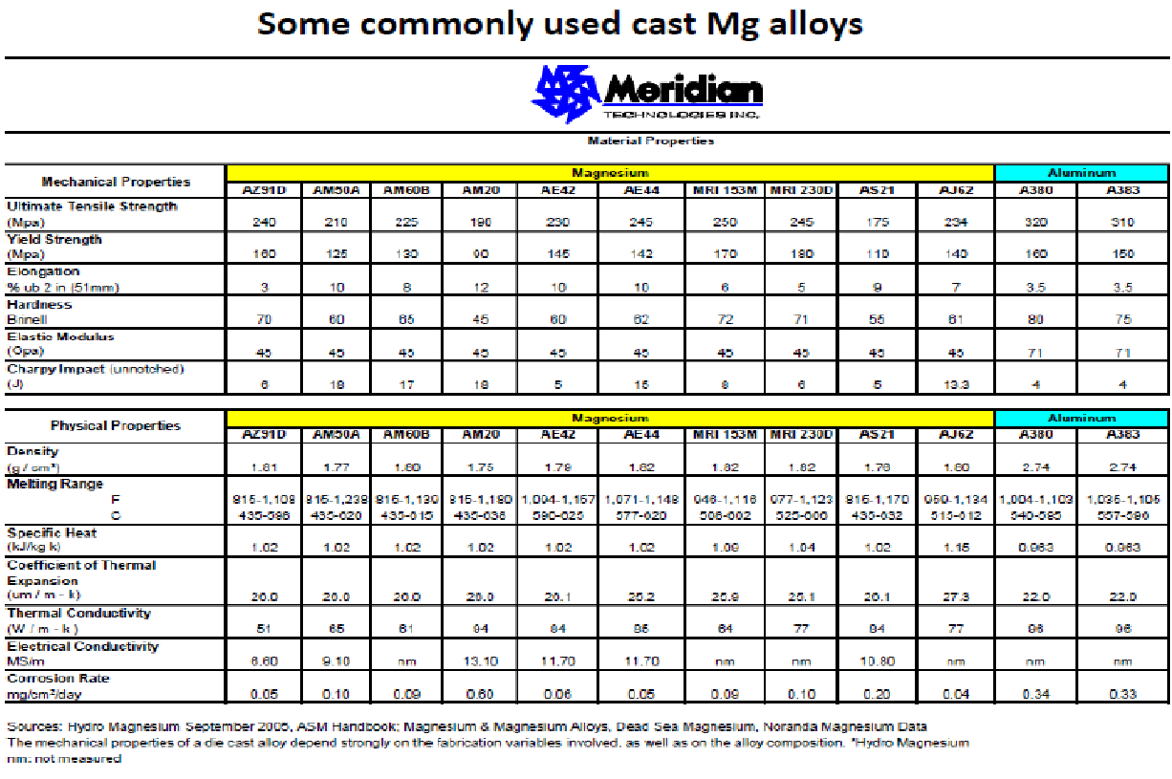

Slide 14
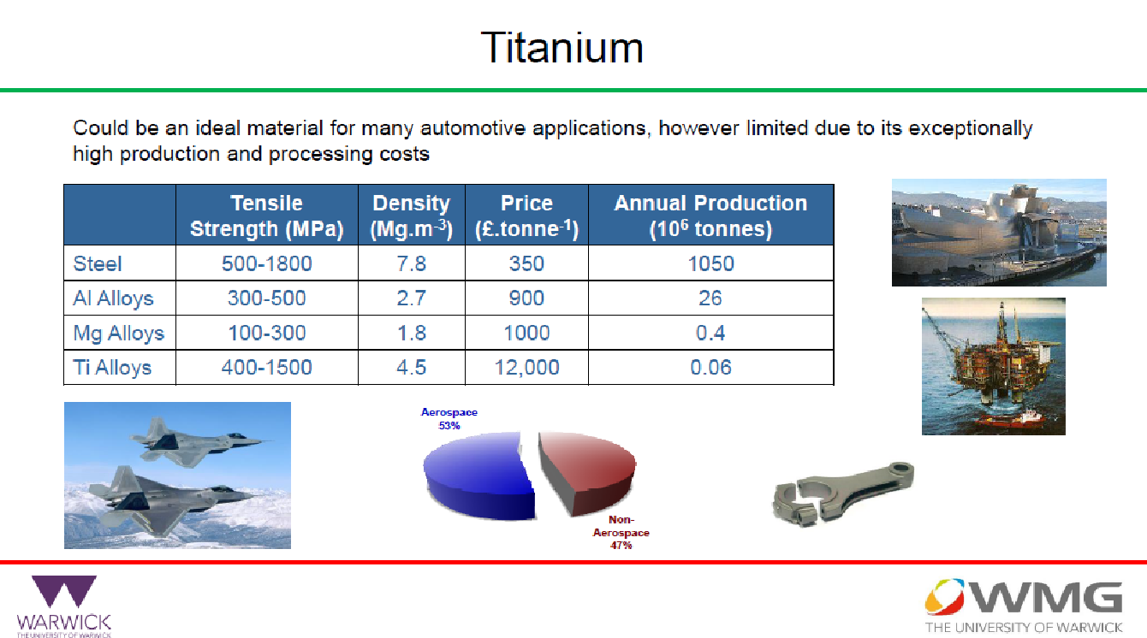

Slide 15
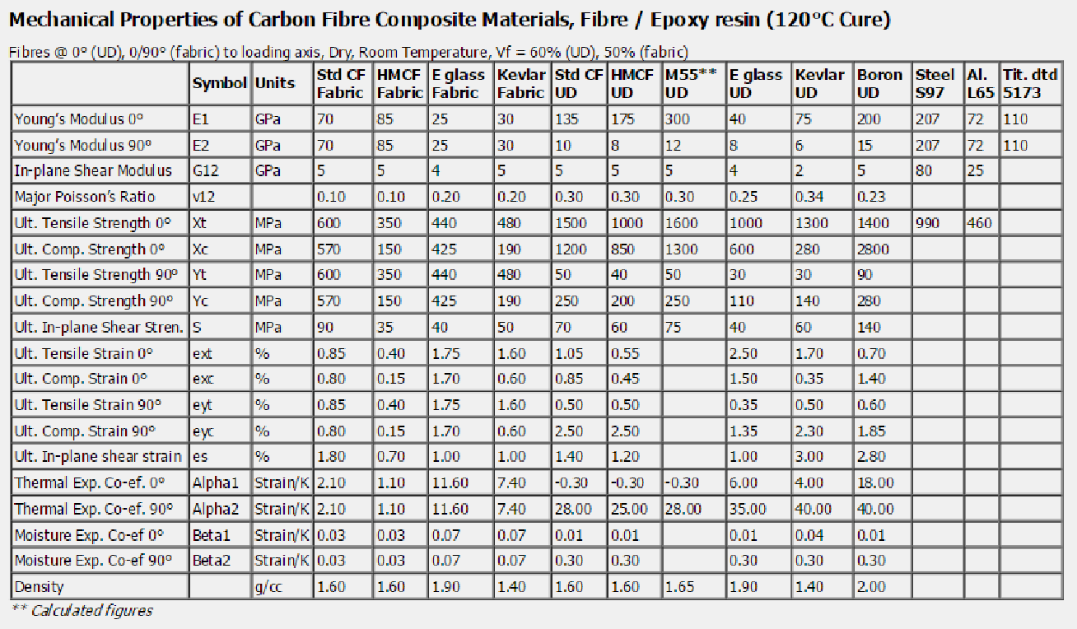
Composite Properties

